Slide 1



Presentation
Welcome To The

Slide 2


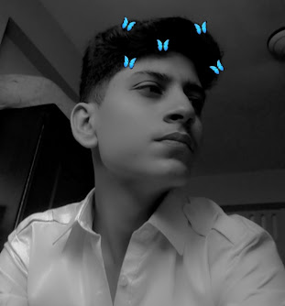
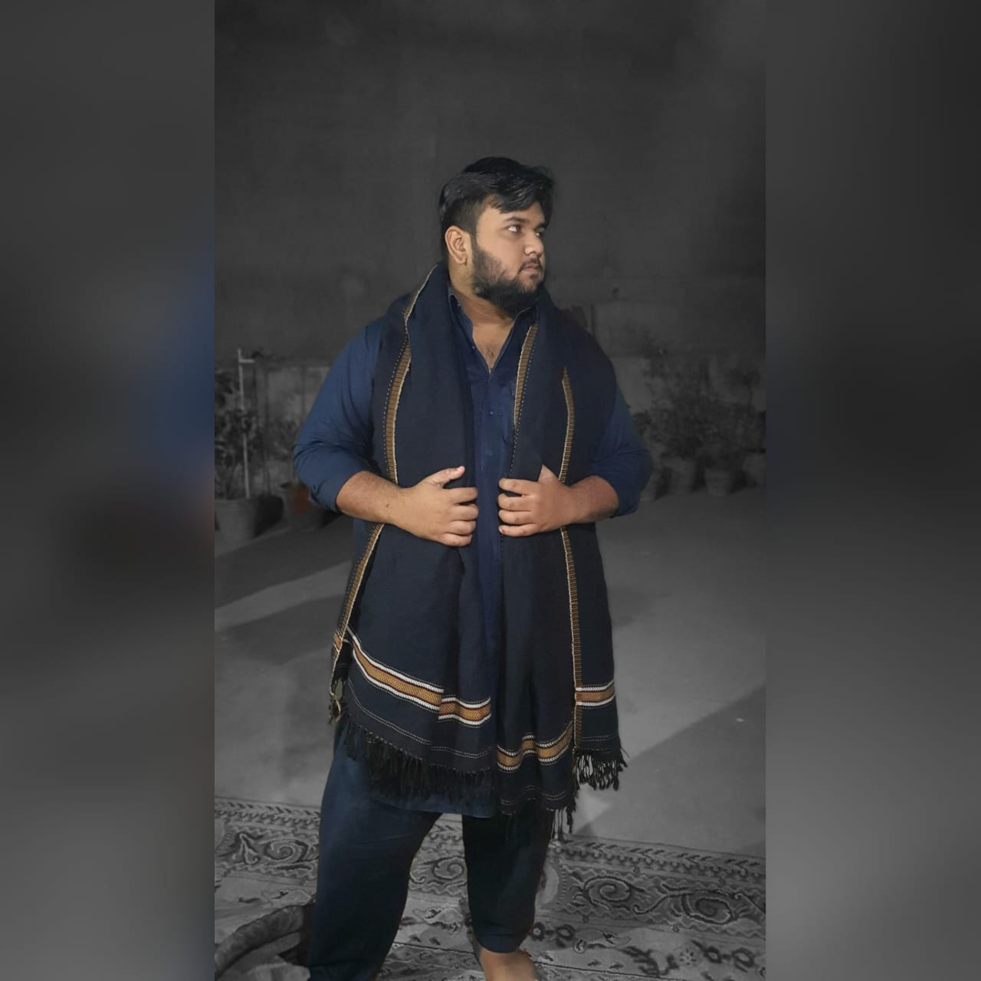
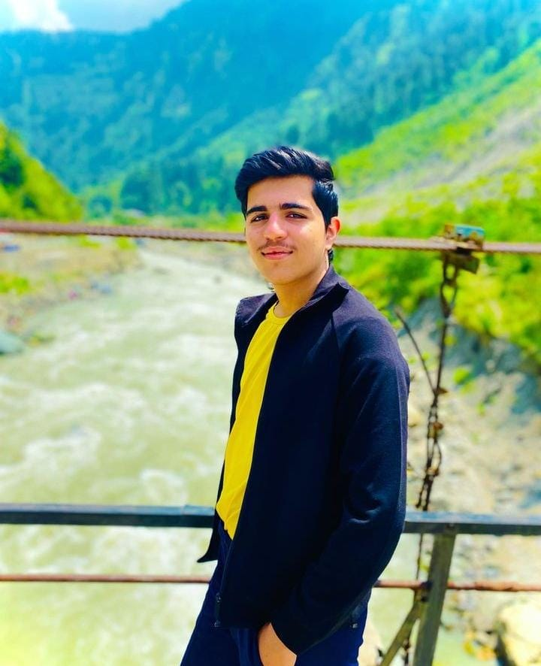
Team Members
Moin Muneer
Hammad
Course: CPISM
Arham
Teacher:
Miss Fatima
Ashhad

Slide 3
CERTIFICATE
This is to certify that this project entitled
“FOTOLAB” submitted in partial fulfillment of the ACCP EE done by following candidates.
Hammad
Arham
Ashhad

Slide 4
Acknowledgement
We are Thankful to ALMIGHTY ALLAH that by HIS Grace we have been successful. We are presenting our Project we have tried our best to take all relevant and necessary topics into our consideration so that this project may become comprehensive.
This is our 1st Semester. We have strived for a better outlook to come. This project has been developed in Visual Studio Code using HTML, CSS & JavaScript. We have been assigned to make a Website namely as our Cpism Project. We tried to observe the coding and its layout in Visual Studio Code. We find it easy to utilize the editor.
We would like to thank Miss Fatima for his guidance and for giving us time from their busy schedule.
We also express our sincere gratitude to E-Project team from APTECH CLIFTON CENTER, for their valuable guidance and support for the completion of this project.
We earnestly hope that this project will provide all the necessary information required by the user to fulfill his/her inspiration. However, suggestion and feedbacks for improvements will be thankfully welcomed & acknowledged.
Thank You.

Slide 5
REQUIREMENTS
The Web site is to be created based on the following requirements:
1. The Home Page should be created making use of Sections with a suitable logo, the header section can be added which will show images of related products.
2. The site must contain the links to navigate through any category for the information.
The site should display a menu which will have categories of all products.
Few products expected to be included are mentioned below, however more
can be added.
      Cameras: all types of cameras should be included
      Camera lenses : varieties of lenses to be included
      Pro audio: related audio accessories options to be included
      Memory cards & media : related products
      Tripods & supports
      Lighting & Studio
      Camera bags & cases
      Miscellaneous accessories

Slide 6
REQUIREMENTS
The Web site is to be created based on the following requirements:
4. The site should contain the options for brief introduction about the various products available, location of the shop and
any other information if required.
5. The information should be categorized according to the brand names of the products like if a User wants to see only “yashica” cameras or any other company products then he/she can click on a Link/button/menu etc and can see only that Brand products.
6. When a user selects any particular brand, a list of products for that brand will be displayed
7. A brief summary of features of the respective item should be displayed on the Web Page along with the picture but detailed Features should be stored in Individual Word documents which can be downloaded or viewed by the User who wishes to see the same.
The user should also be able to compare the various products of different as well as similar brands.
9. There should be a “Contact Us” page which will have the Address of the Company which should be displayed using GeoLocation API (eg. GoogleMaps) and the email address which when clicked will invoke the local mail client from where they can send an email.

Slide 7



"If you can see it, you can shoot it."

Slide 8




Buy camera for personal or professional use

Slide 9



Cameras
Bags
Lenses

Slide 10
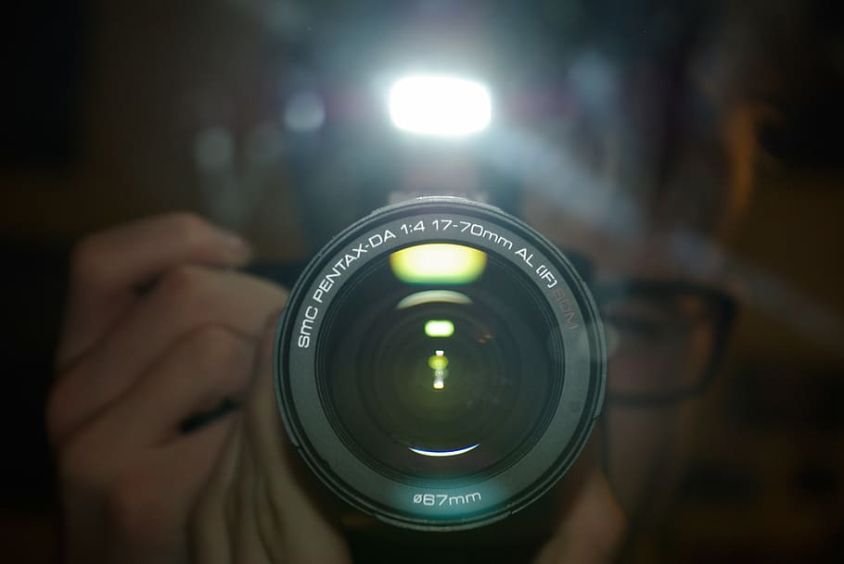
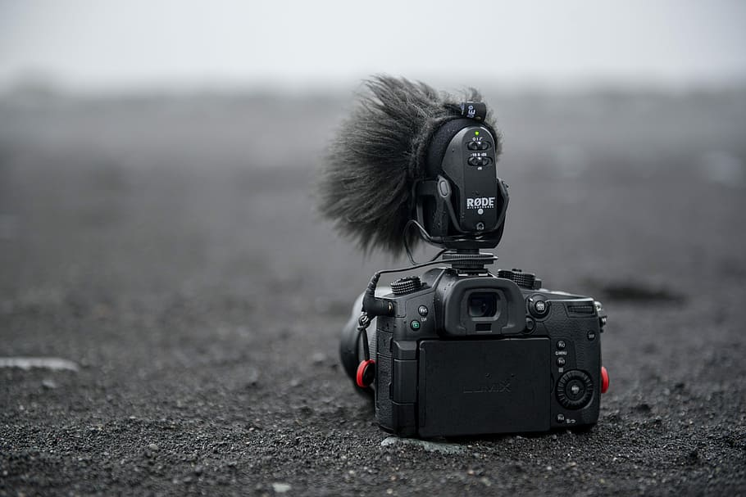
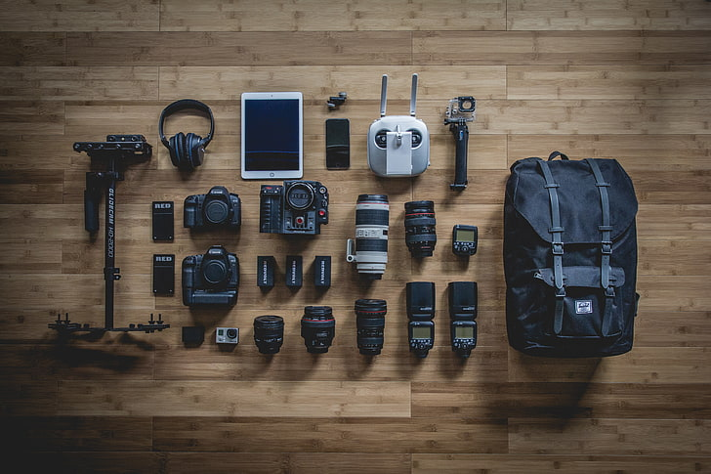
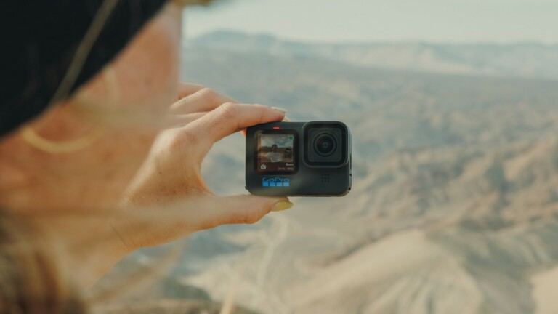
Many More…

Slide 11







Easy to Contact us:

Slide 12
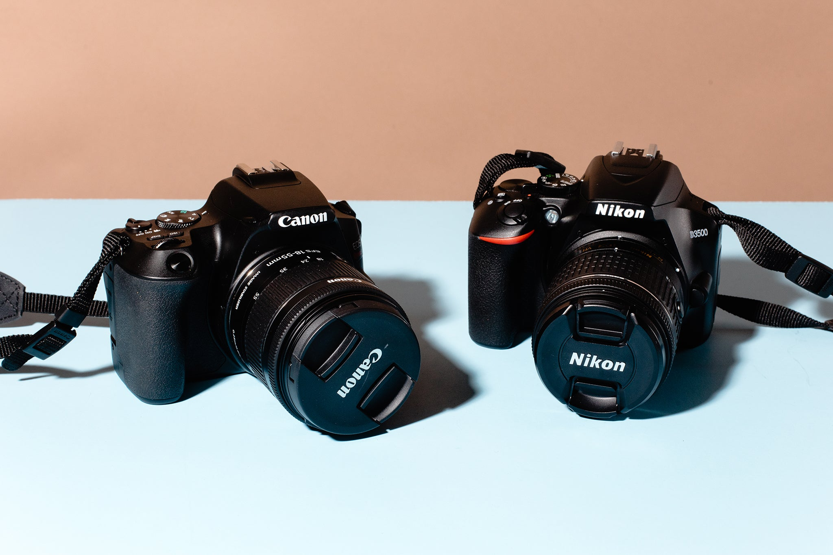




Easy Buying & Fast Delivery
www.fotolab.com
Buy Cameras or much more at reasonable price

Slide 13
TASK SHEET
Project Ref. No. |  | Project Title | Date of Preparation of Activity Plan
S.No. | Task | MERCIADO | Actual Days | Team Mate Name | Status
1 | Analysis |  | 25 | Hammad, Arham, Ashhad | OK
2 | Design |  | 25 | Hammad, Arham, Ashhad | OK
3 | Development |  | 25 | Hammad, Arham, Ashhad | OK
4 | Testing |  | 25 | Hammad, Arham, Ashhad | OK
5 | Documentation |  | 5 | Hammad, Arham, Ashhad | OK

Slide 14
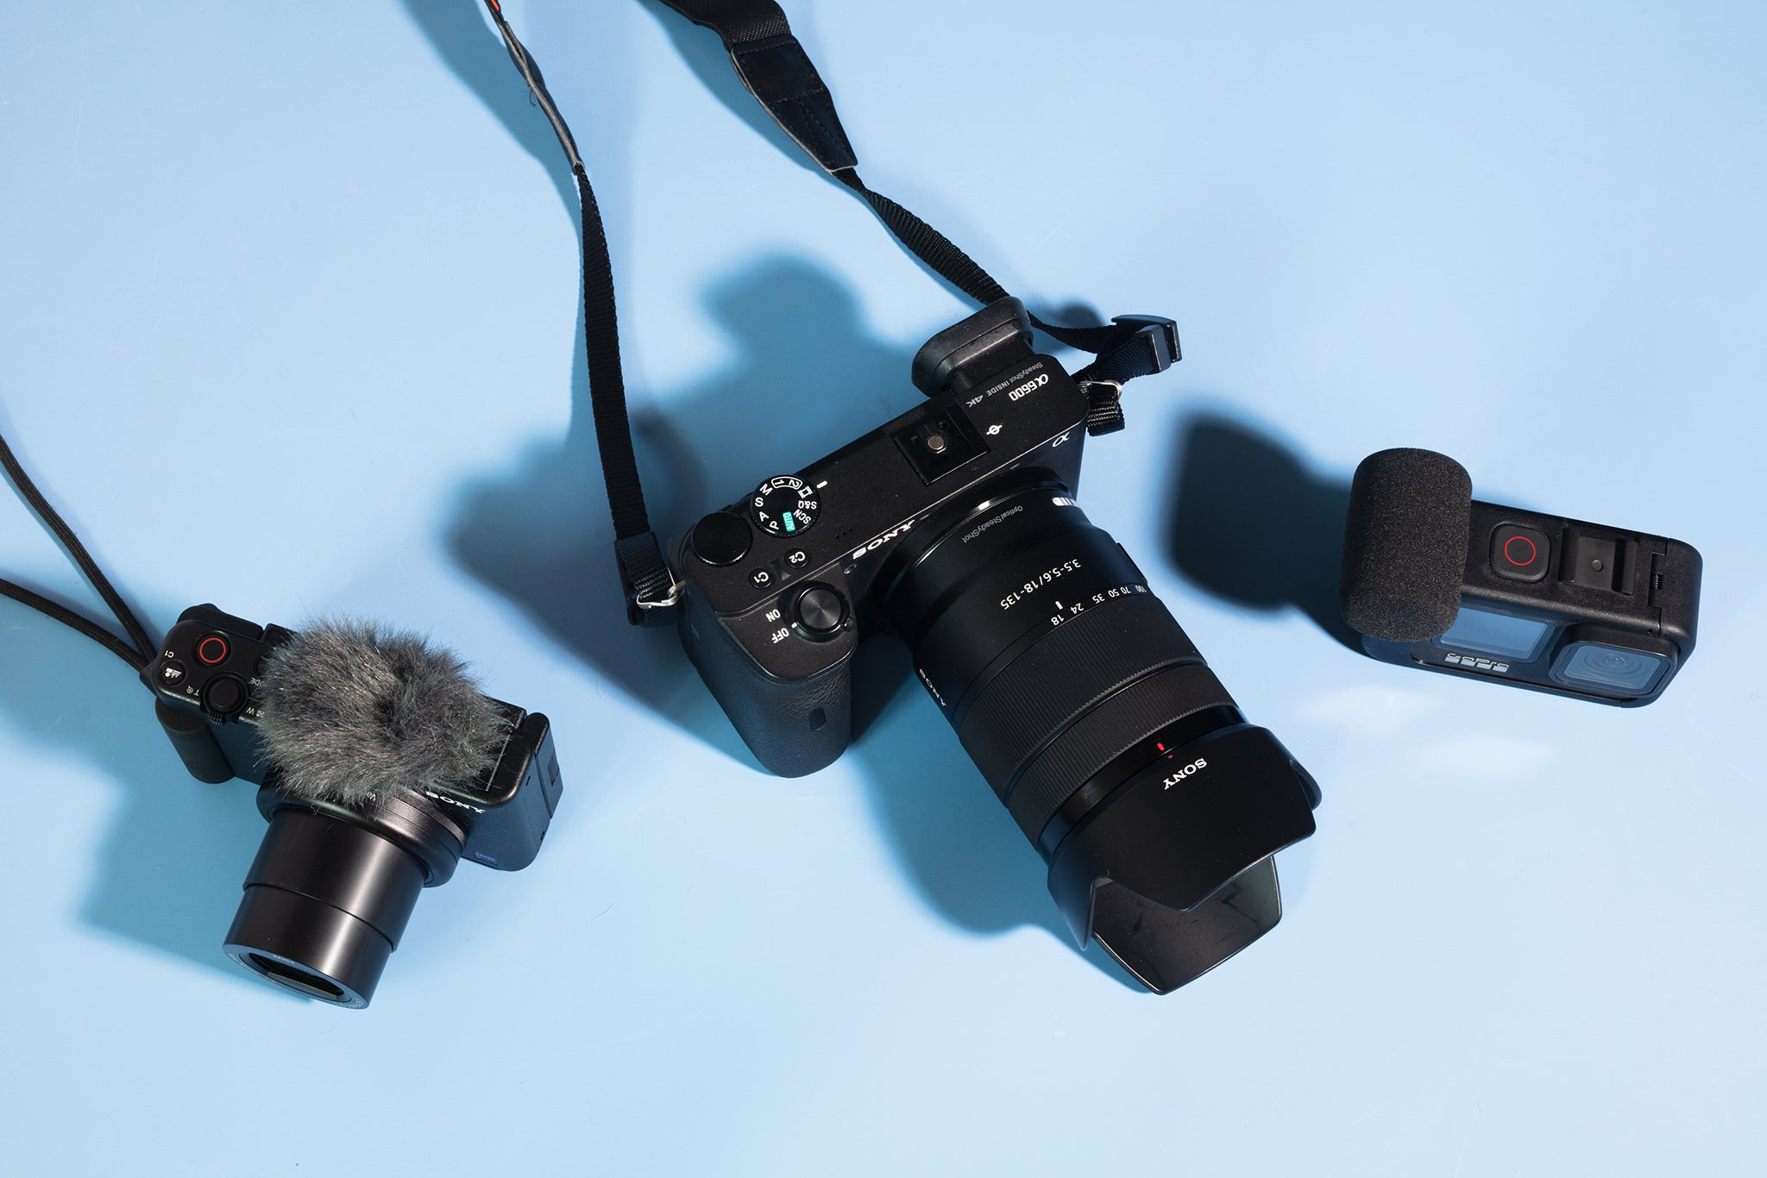
Thank you

